Slide 1
Ascension Technology
C.A.R.
Matthew Darby, Maggie Burton, Weston Straw, Mark Du, Andrew Case, Stevie Damrel

Slide 2



Where we are now, Chapter 3: a completed project

Slide 3
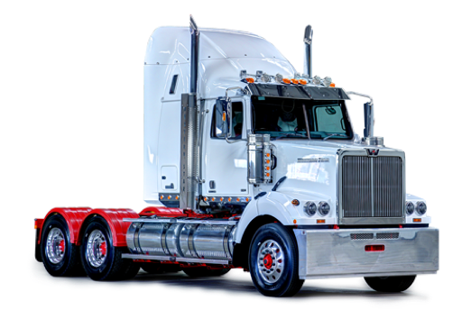
And now for a demo…

Slide 4
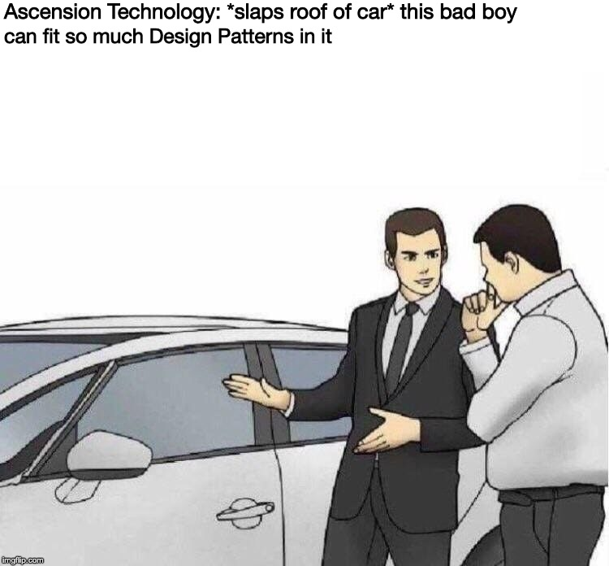
Design Patterns

Slide 5
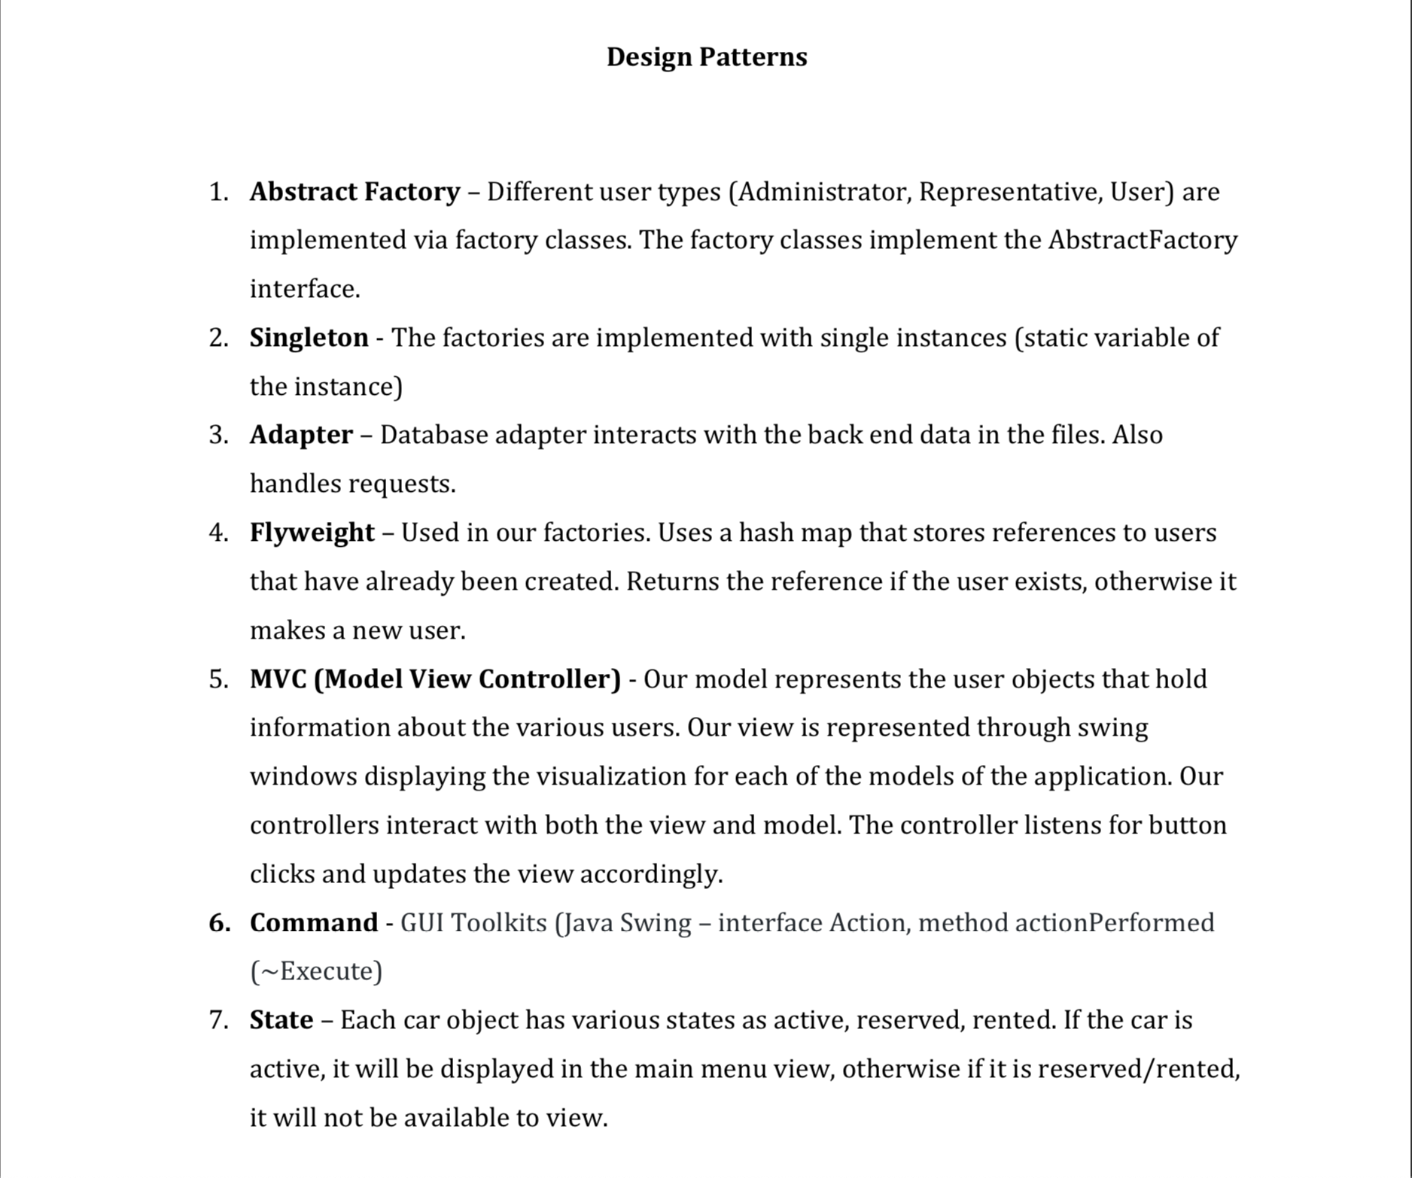

Slide 6
Class Diagram

Slide 7
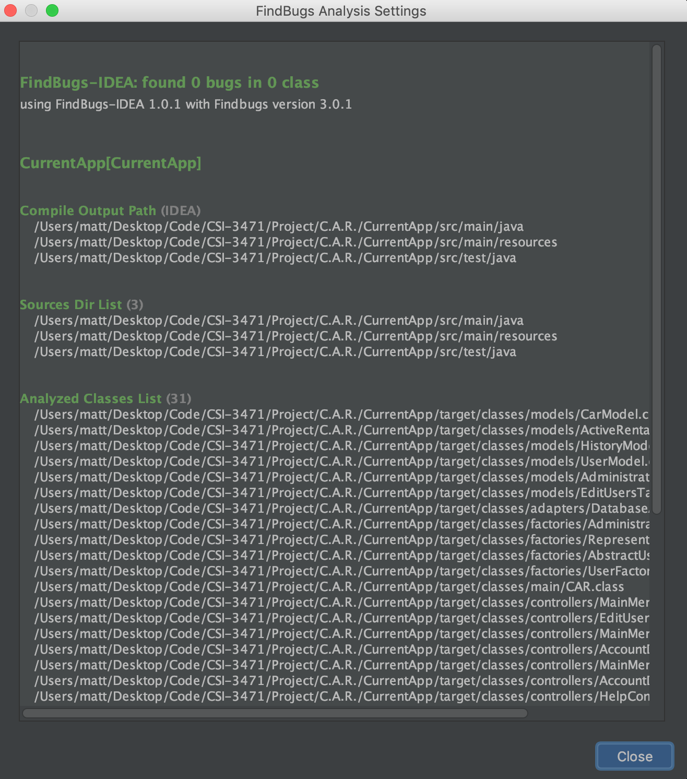
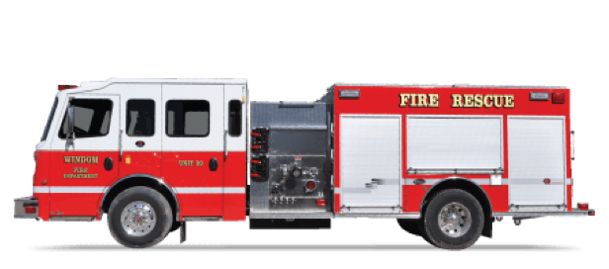

Slide 8
Communication Diagram: User Rent Car

Slide 10
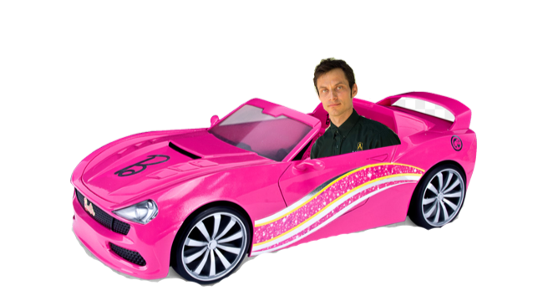
Website
https://baylorsailor.github.io/C.A.R./site

